Slide 1
Introduction and Setup
Databases to Dashboards

Slide 2
Course Goals and Objectives
Compose data analyses in R Markdown and Quarto
Interact with relational databases through R
Combine iteration with common R functions to scale routine activities
Understand how automation tools can be configured to support frequently repeated activities
Develop dashboards to communicate data analyses efficiently
Notes:
Obviously we would love for those who are here today to all walk away and just start coding but the reality is that while that would be great we also have a set of more modest if more important goals
We're here to Advocate for the use of R as a means of improving reproducibility in clinical data analysis and I cannot emphasize enough how strongly we feel about this point
As we review this we will demonstrate how we can use R perform analyses of laboratory operational data
And we also hope to establish a baseline understanding of what tidy data is and how to implement a 'tidy' approach to data analysis within the framework of R

Slide 3
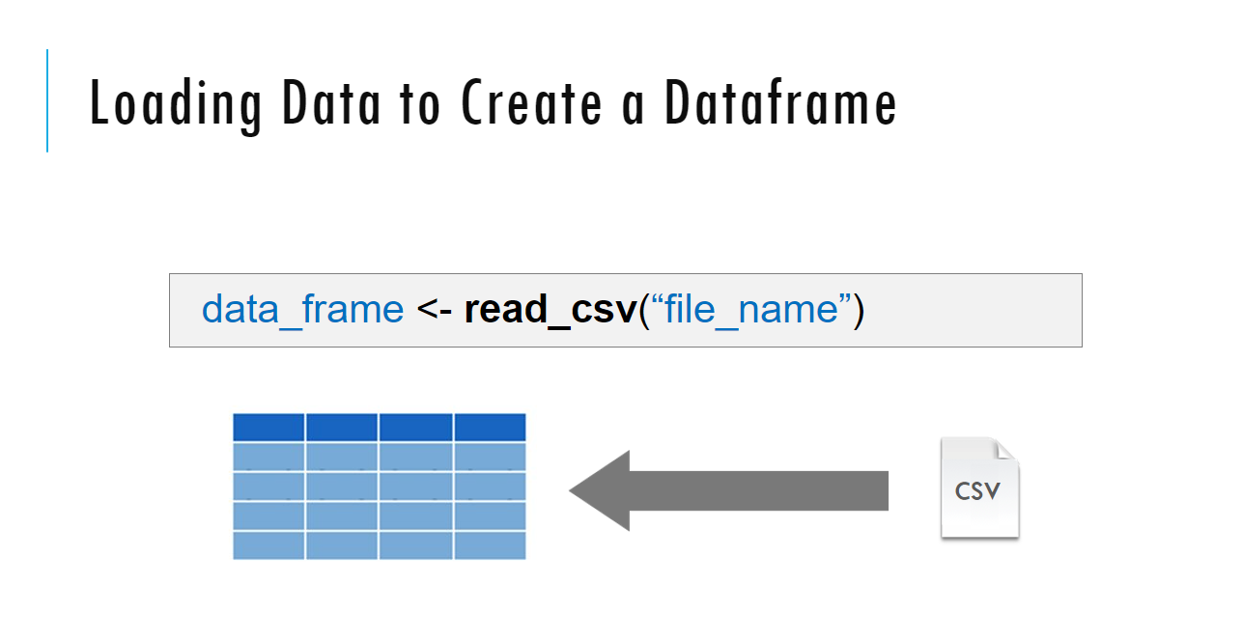
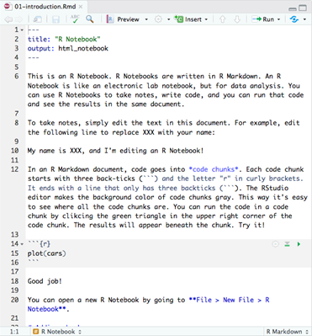
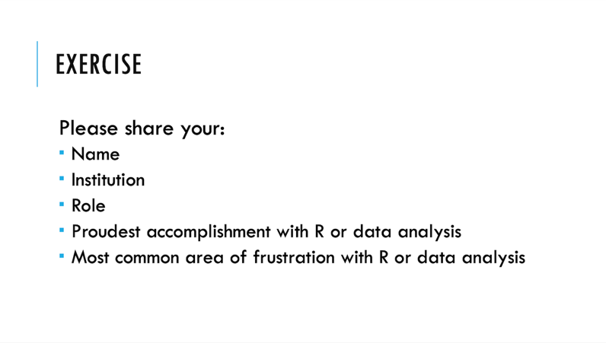
Sessions
Notes:
The meat of the workshop are the sessions each of which will cover discrete subjects or components of R in a data analysis. The sessions have a powerpoint associated with it as well as an R script.
We'll be describing a specific function or topic in the context of the powerpoint – all of which are included in the coursebook and available for download. The same code that is being demoed is included in the R script and you are invited to follow along, run the code, play with it if you like.
At several points in the session we'll have you engage in some exercises which we call Your Turns. In a Your Turn we'll assess how we're doing by asking you to critically think about the topic in the session and respond to a question or do some coding on your own. We'll speak a bit later about how these coding exercises will work.

Slide 4
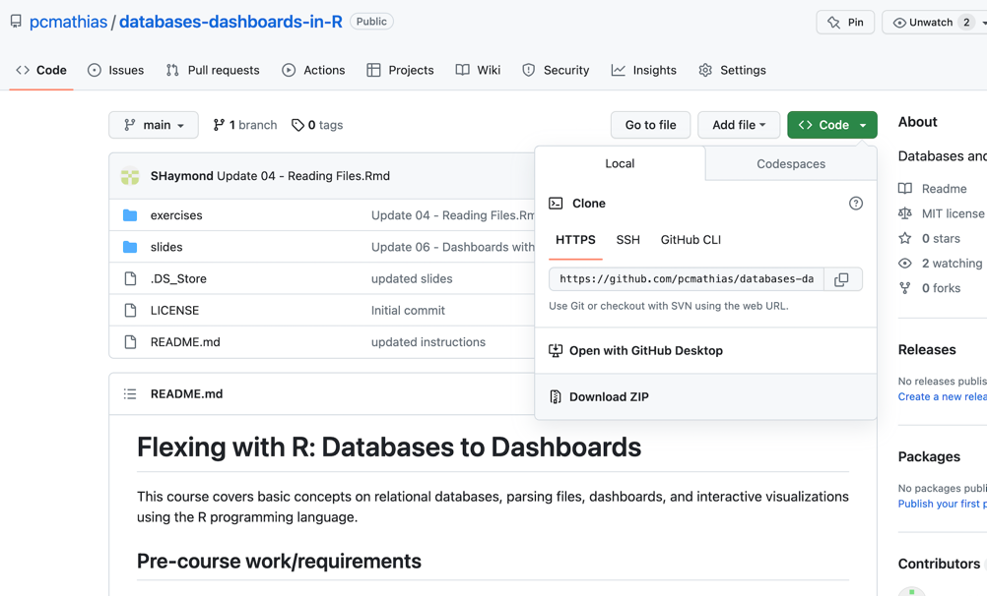
Course Setup: Get Materials
If you have Git installed you can create a project
Course contents can be downloaded and unzipped
Confirm you have the MSACL_db_data.zip file!
Click link on site if you don’t!

Slide 5
Course Setup: Project Destination
Put your unzipped folder on a file path without spaces (especially on Windows!)
E.g. C:\USERNAME\Desktop\

Slide 6
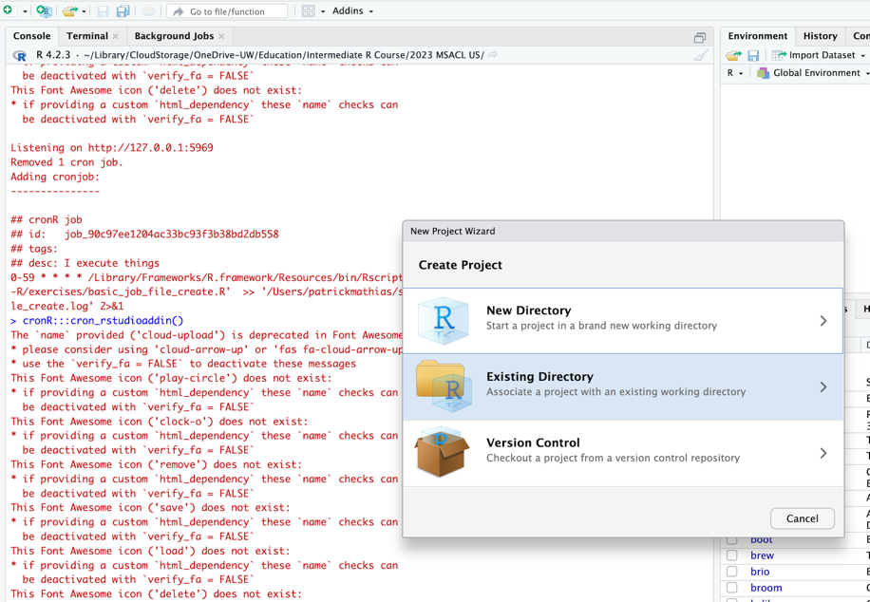
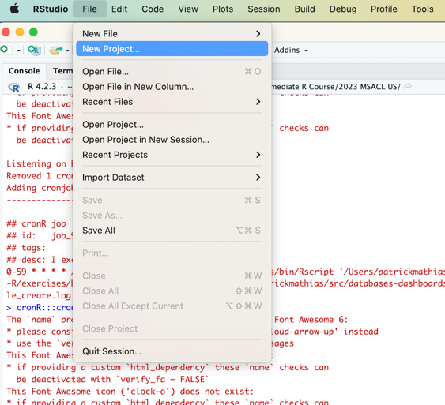
Course Setup: Create Project With Existing Directory

Slide 7
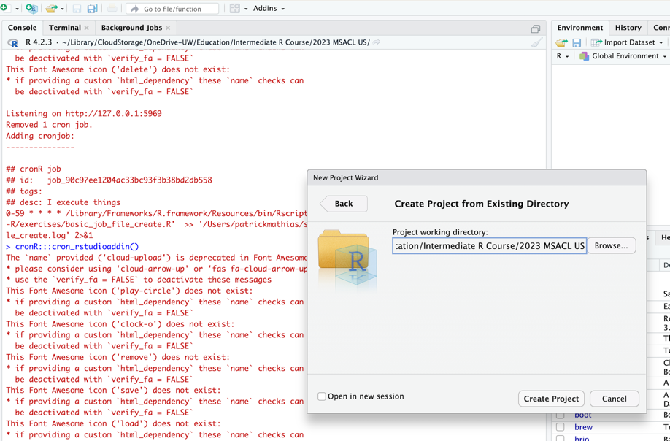
Course Setup: Create Project With Existing Directory
Select folder with unzipped contents from repository

Slide 8
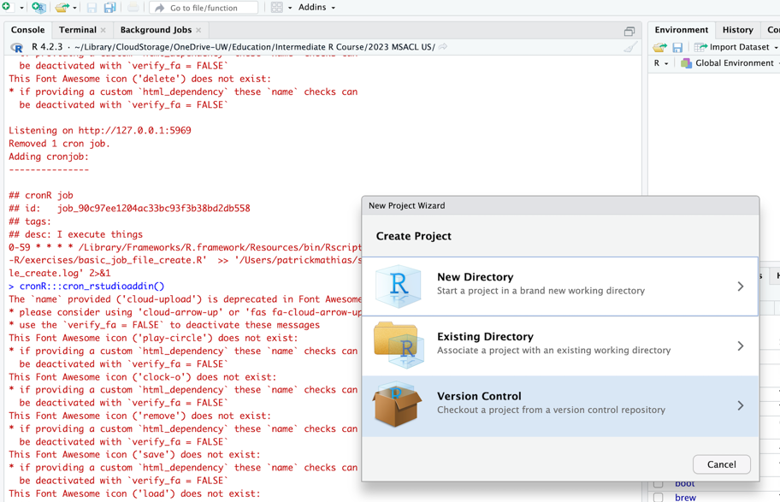
Course Setup: Create Project from Version Control If you already have Git Installed

Slide 9
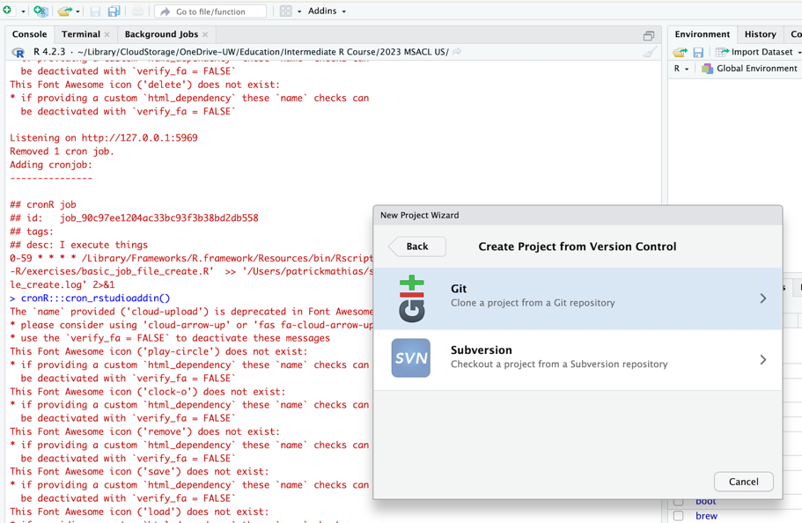
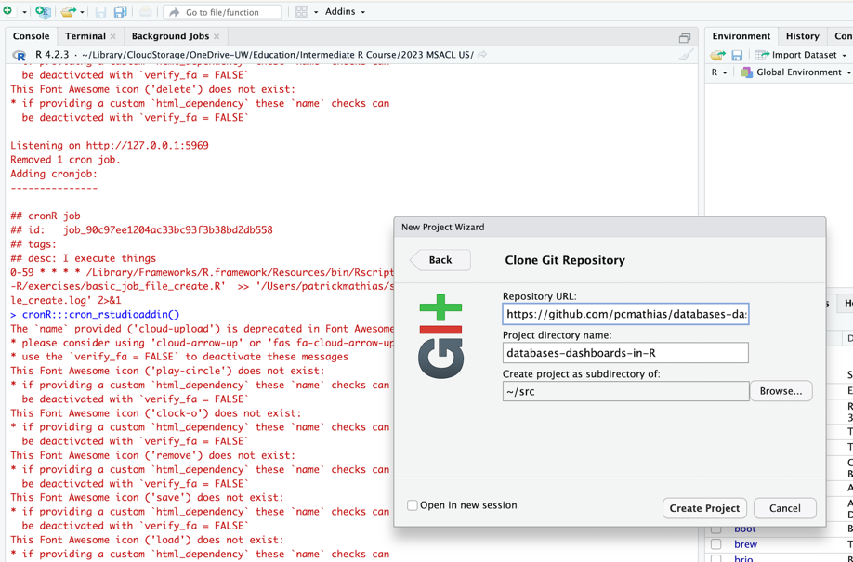
Course Setup: Create Project from Version Control If you already have Git Installed

Slide 10
Course Setup
Locate MS_db_data.zip (download from pre-course instructions) or re-download
Unzip MS_db_data.zip
Place unzipped “data” folder into “exercises” folder in your course contents folder
This will be needed to run R Markdown exercises without modification

Slide 11
Exercise
Please share your:
Name
Institution
Role
How you use R and/or want to use R
Proudest accomplishment with R or data analysis
Biggest area of frustration with R or data analysis

Slide 12
Tips for learning
Cheatsheets show how to do common things – orient yourself with them early
The best way to learn to code is by doing
Practice is key!
Programming is hard, even for those with a lot of experience. Find resources and ask for help!
ChatGPT and other large language models can also help! But verify everything!
Notes:
And just some final words before we begin, no matter what you're learning but particularly coding, the best way to learn is by doing:
Find a project, make a goal for yourself, push yourself to use R, it's OK to lean on some excel, we all do when we're starting out, but try to get that activation energy to get your hands typing code. We would not be teaching this course if we didn't strongly believe that R is accessible to all of you. So keep practicing and you'll get there.
With that let's get started with the workshop. Up next Joe will provide us with the basics of R and get us up and running with Rstudio Cloud.

